Slide 1

Concur Training
- Office
Request & Expense

Slide 2
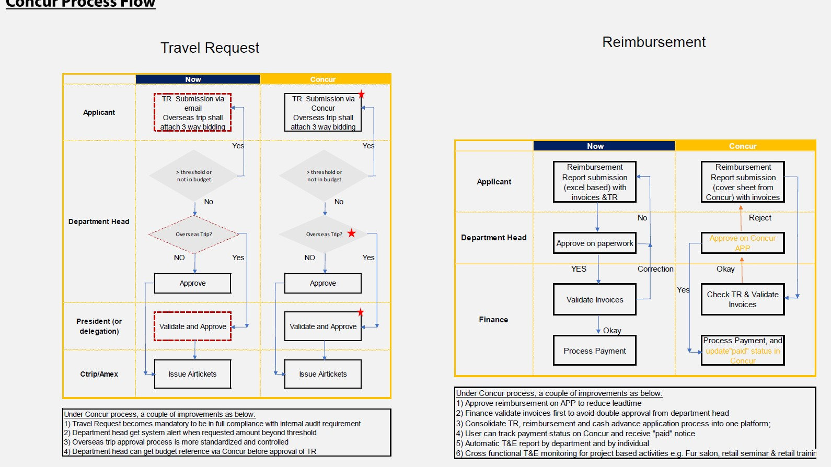

Slide 3
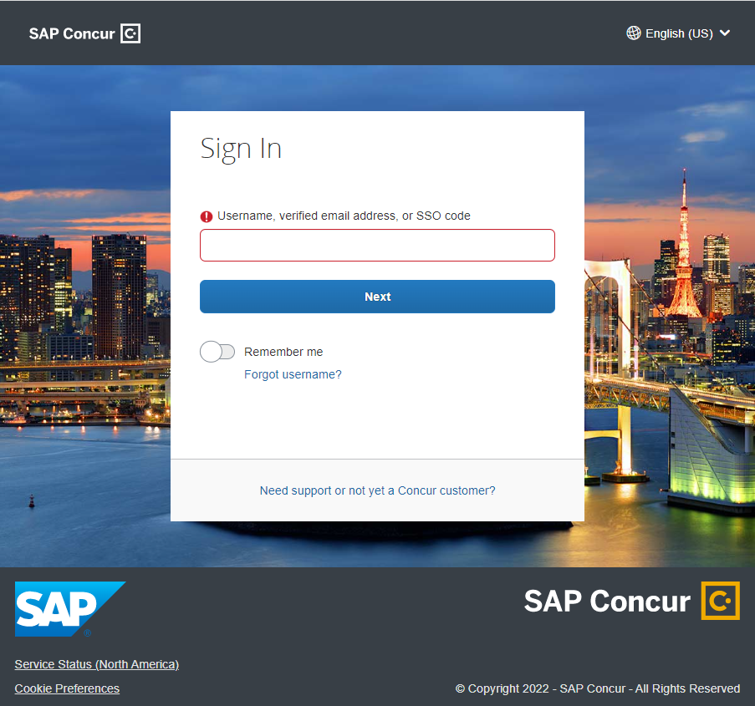
Login Concur
https://www.concursolutions.com
User name = Email address
Password

Slide 4
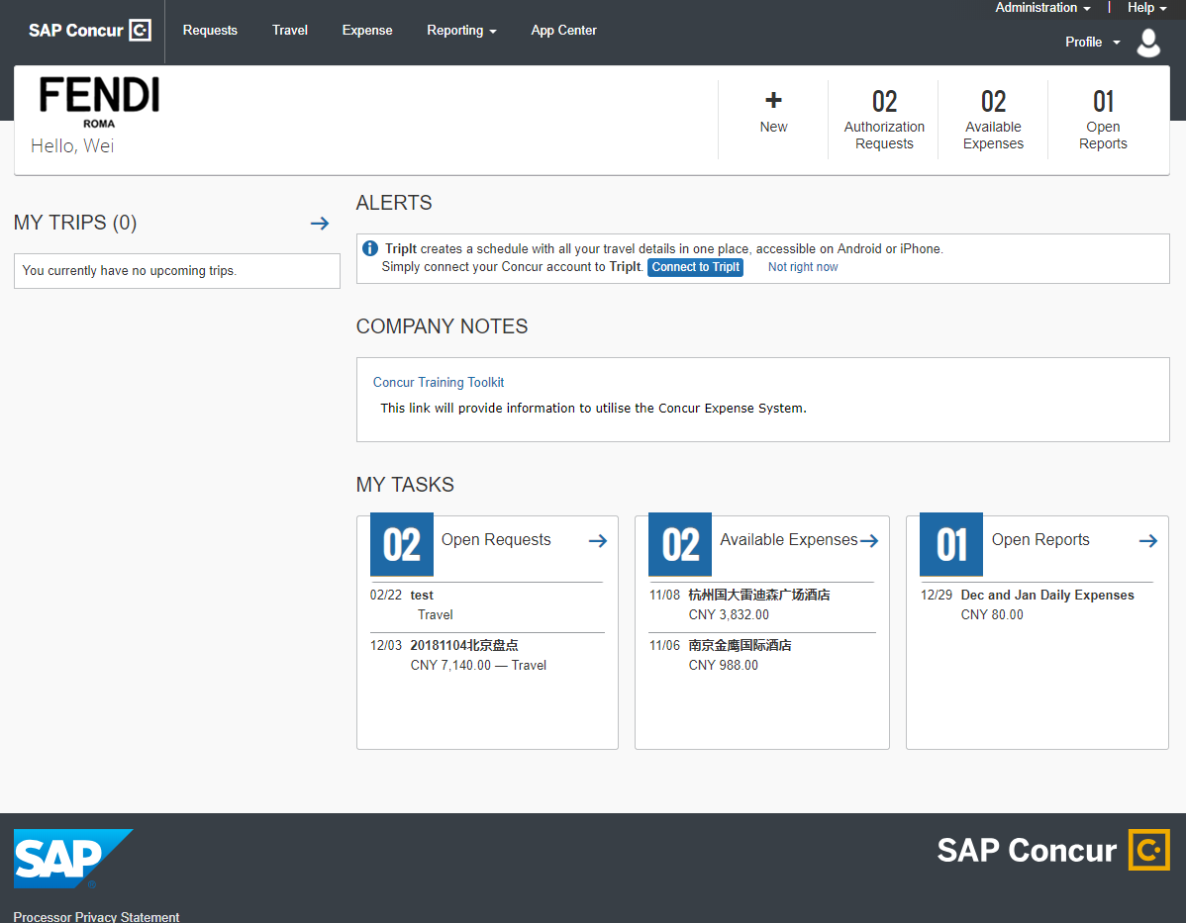
Start a Request
Click on New and choose Start a Request
OR Click on Requests and choose New Request

Slide 5
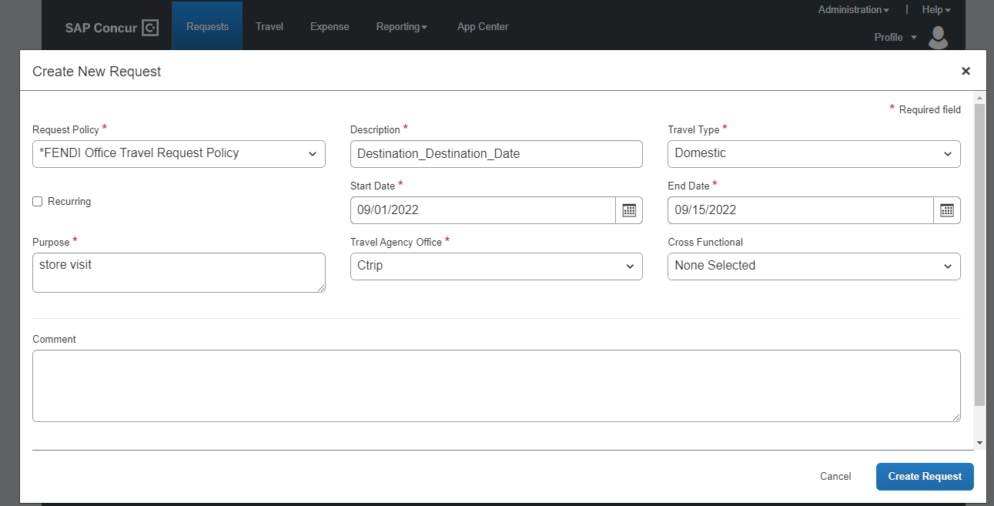
Request Header
Complete all mandatory fields marked in red
Request Policy = “FENDI Office Travel Request Policy”
Description = Destination_Trip
Description_Departure Date
Travel Type = Domestic/AP/Out of Asia
Recurring = generally refers to overseas business trips for buying, fashion show, high fur event, worldwide seminar. etc.
Purpose = travel purpose details
Travel Agency
Ctrip = domestic trip
Amex = Asia/Out of Asia
Once finished, click on the next tab Segments

Slide 6
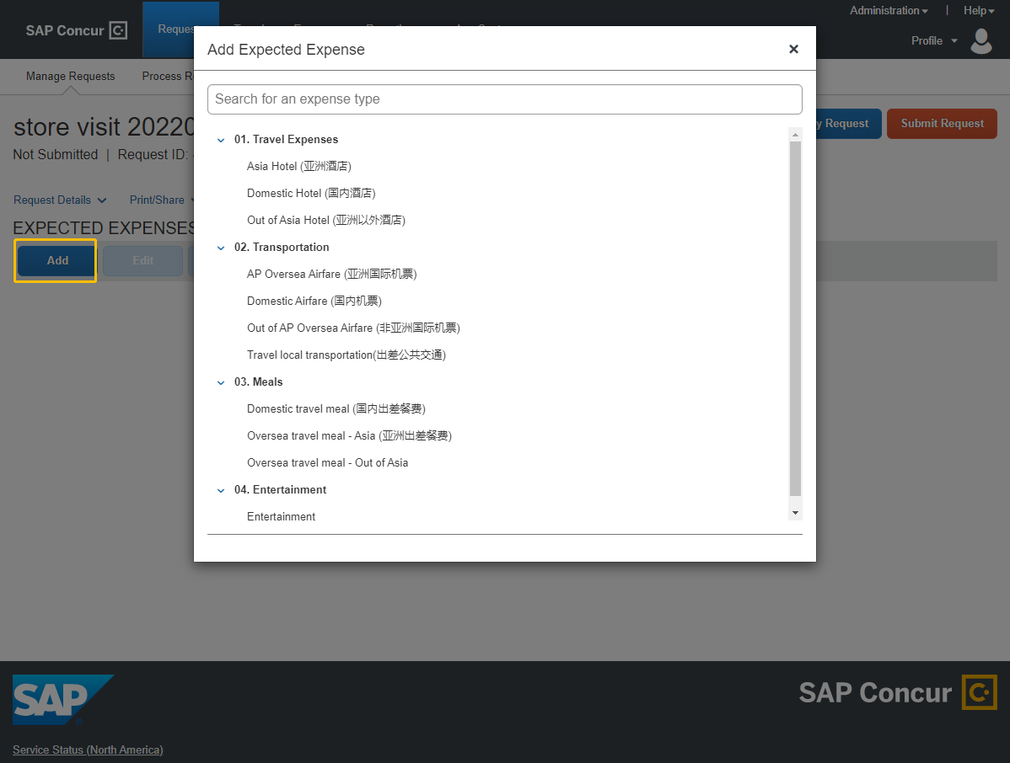
Select Expected Expenses
Click on Add and choose Start a Request
Choose Expected Expense

Slide 7
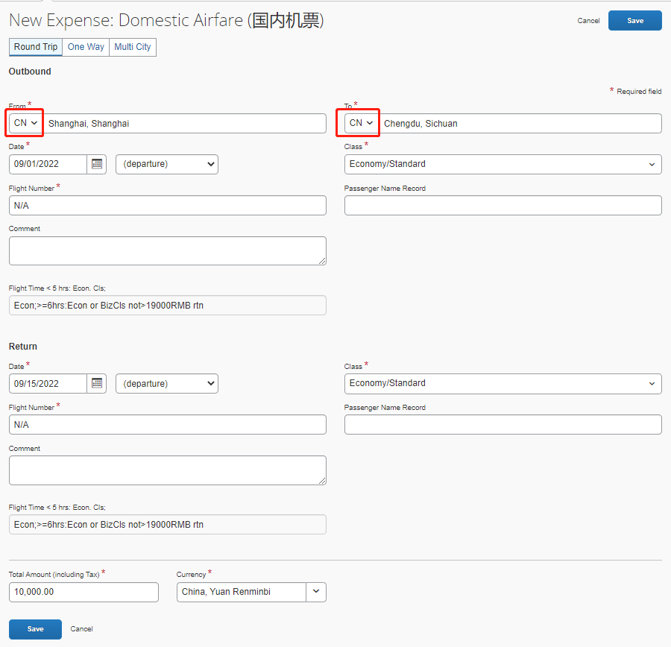
Airfare
Select airfare type: Round Trip /One Way/Multi City
Total Amount: Please put an estimated amount if the flight is not booked yet.
From/To: Please choose the departure/destination country and city
If the trip includes flight connections, please do not include the stopovers. Only fill in the departure and destination city.
Date = flight date (local time)
Class = Economy/Business
You may refer to your T&E standard at the bottom of the section.
Flight Number: Put N/A if the flight is not booked
yet.

Slide 8
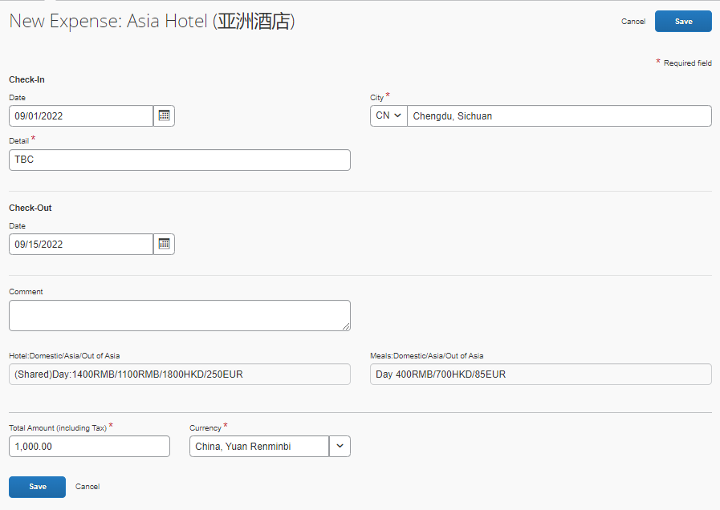
Hotel
Total Amount: Please put an estimated accommodation fee. For international travel, please choose the currency accordingly.
You may refer to you T&E standard on the bottom of the screen.
City = Hotel location city
If one trip includes multiple hotels, please add the hotels one by one and complete the information of each entry.
Detail: You may input the hotel name if
it is booked already.

Slide 9
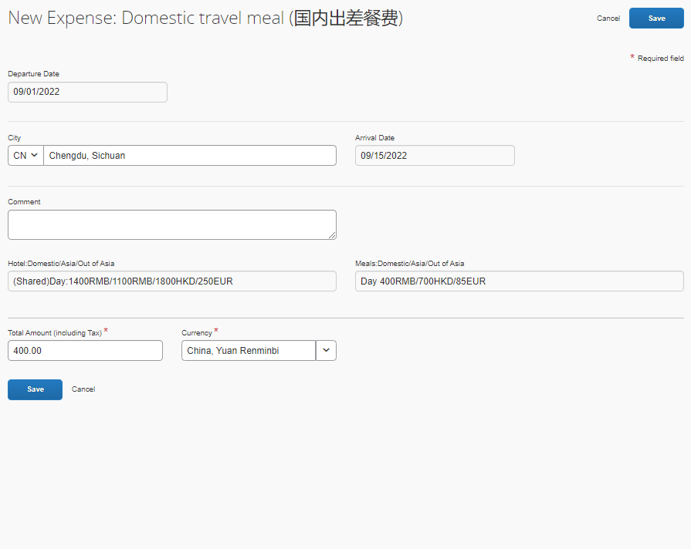
Meal
Total Amount: Please put an estimated accommodation fee. For international travel, please choose the currency accordingly.
You may refer to you T&E standard on the bottom of the screen.

Slide 10
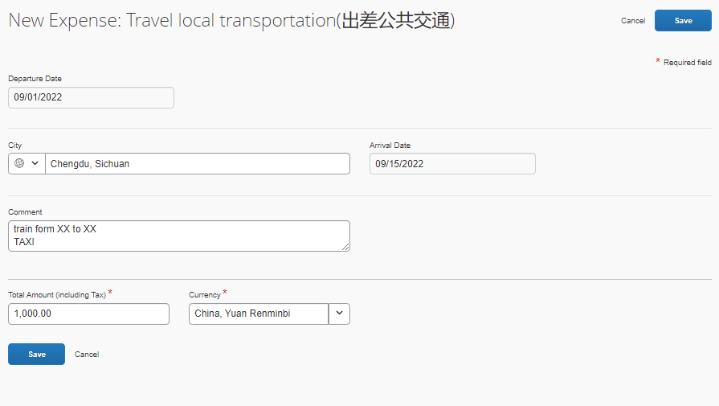
Local Transportation (Train, Taxi, etc.)
Total Amount: Please put an estimated amount. For international travel, please choose the currency accordingly.
City = travel destination city
For train, please specify the departure
and destination info in Comment.

Slide 11
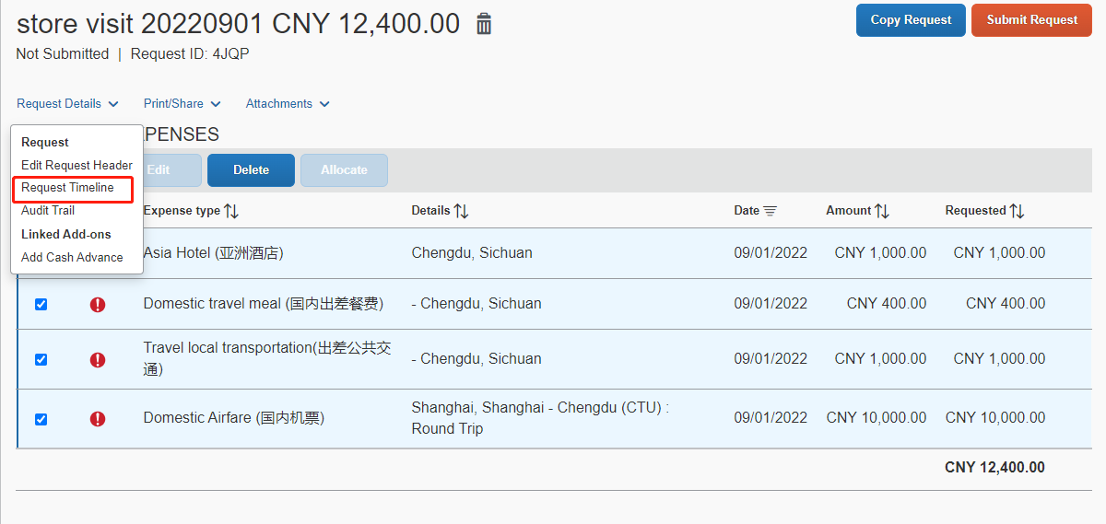
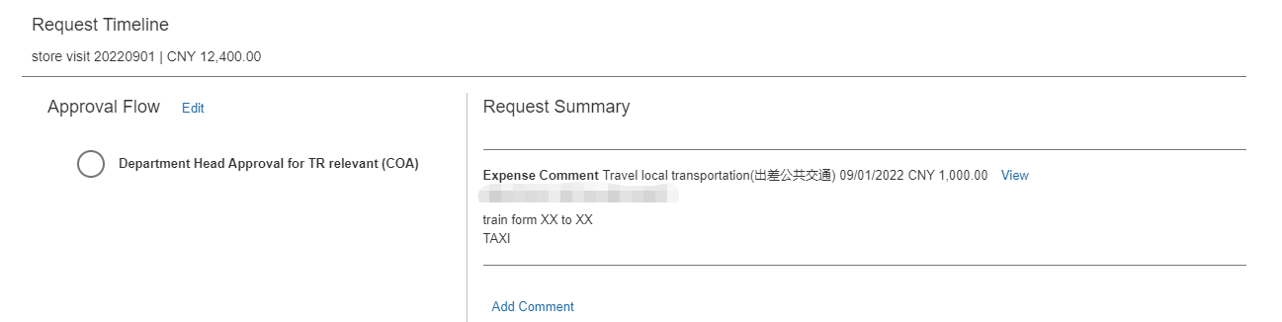
Approval Flow
Once you complete the segments, you may go back and click Request Timeline in Request Details tab to check your approver info. The status will be updated once approved.
Attachments: You need to attach 3-way bidding documents for international flight.
Before you click Submit, you may check all the details and the total amount.
If the trip includes any segment in a different currency, the amount will be converted to RMB based on the rate of the submission date.
Once your request is approved,
Domestic flight and hotel, please book with Ctrip.
International flight, please book with Amex.
International hotel, please book with Ctrip.

Slide 12

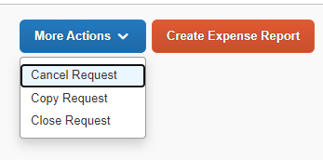
Manage Your Requests
Before Approval
You can view / amend / withdraw your
requests under Manage Request
To CANCEL a request
Click on the request to open it and then click Cancel Request. It will be cancelled and cannot be used for further expense report. The booked budget will also be released.
To RECALL a request before approval
Click on the request to open it and then click Recall. You can do amendments in the request and submit again.
To recall the request, amend and submit again
After Approval
Cannot recall. You can only cancel/close the request.

Slide 13
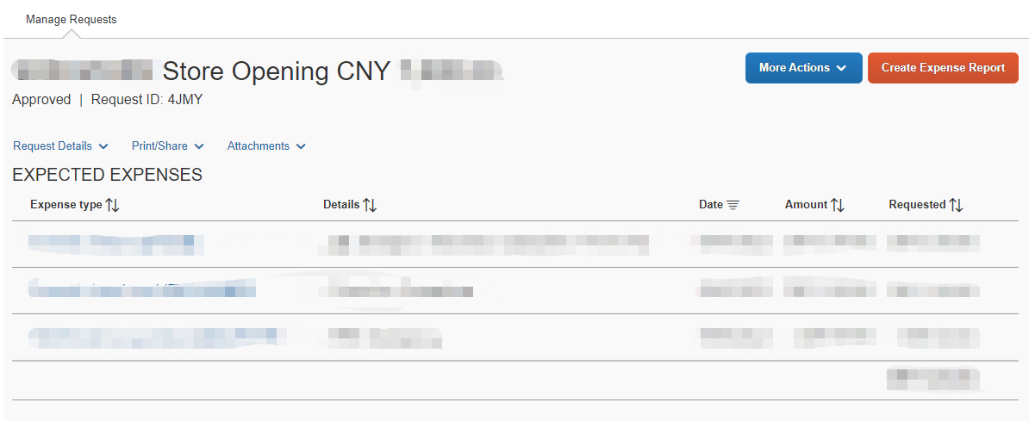

Travel
Expense Claim
Once a travel request is approved, you will see Create Expense Report button under Requests > Manage Requests
The Create Expense Report button is only available when the request is approved.
Each approved travel request can be used only once for expense claim.

Slide 14
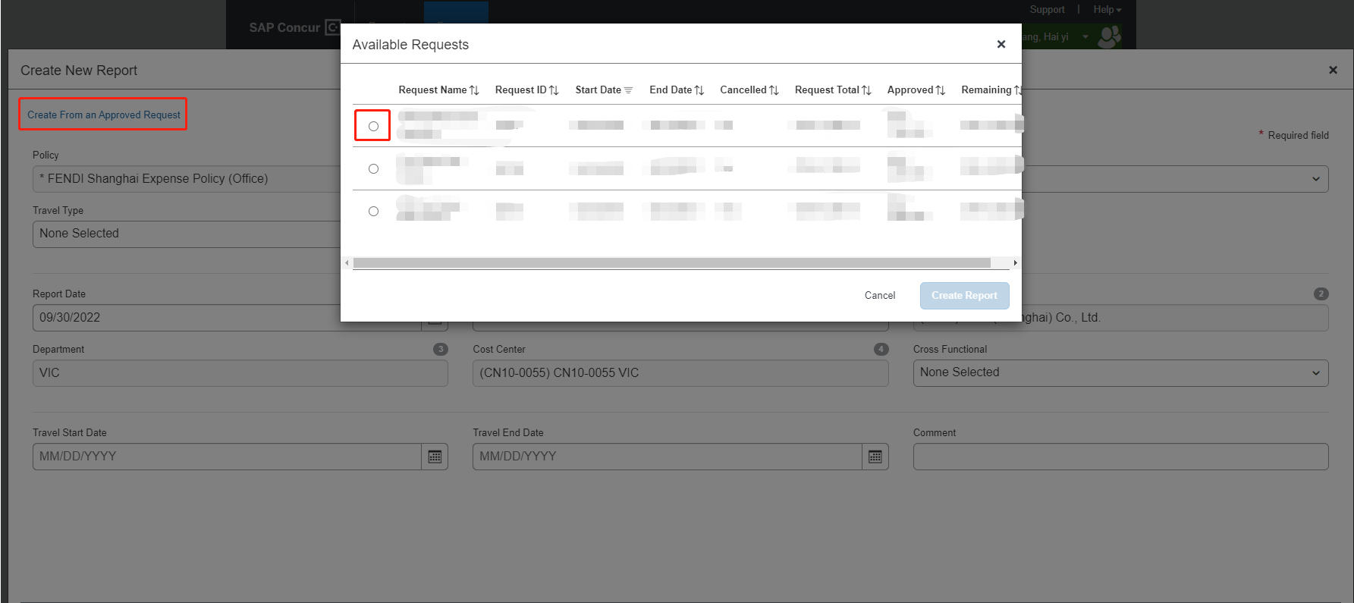
Travel
Expense Claim
Click the link Create From an Approved Request, and choose the available request to link.

Slide 15
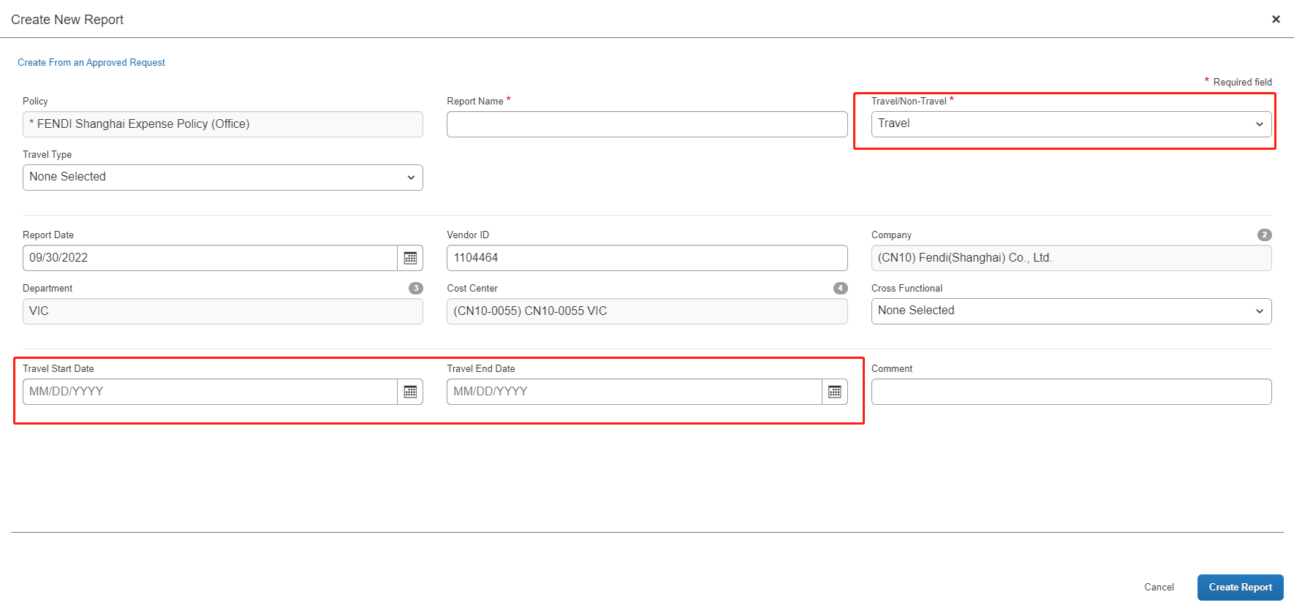

Travel
Expense Claim
Travel Start Date and Travel End Date must be filled in if it is travel expense claim

Slide 16
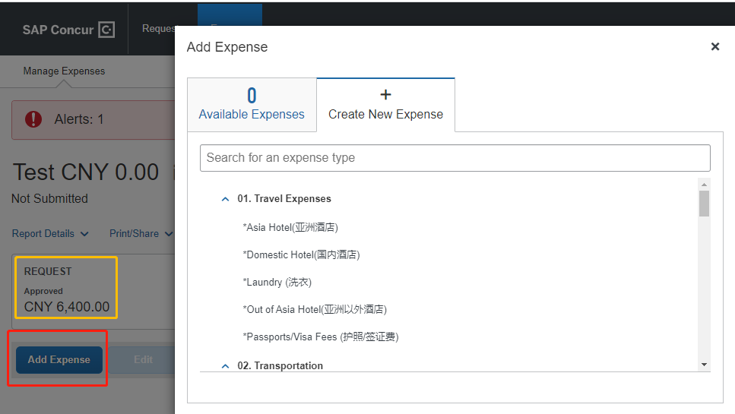
Expense Type
Click on Add Expense and select the appropriate expense type to begin.
The expense claim should be based on your actual expenses. If an exceptional expense has not been included in the travel Request, the system will show a warning message after you add the expense. However, you can still process and submit the expense report.
Travel and non-travel expenses cannot be mixed in one expense report.
You can the linked REQUEST below Report Details.

Slide 17
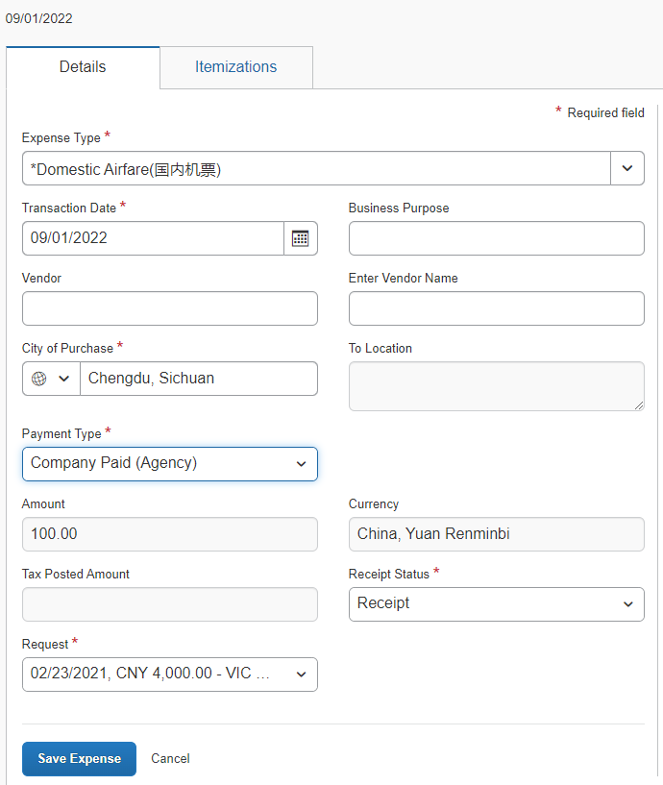
Airfare
City of Purchase ”Flight Destination”
Amount “If different currency has been used, please change the currency accordingly”

Slide 18
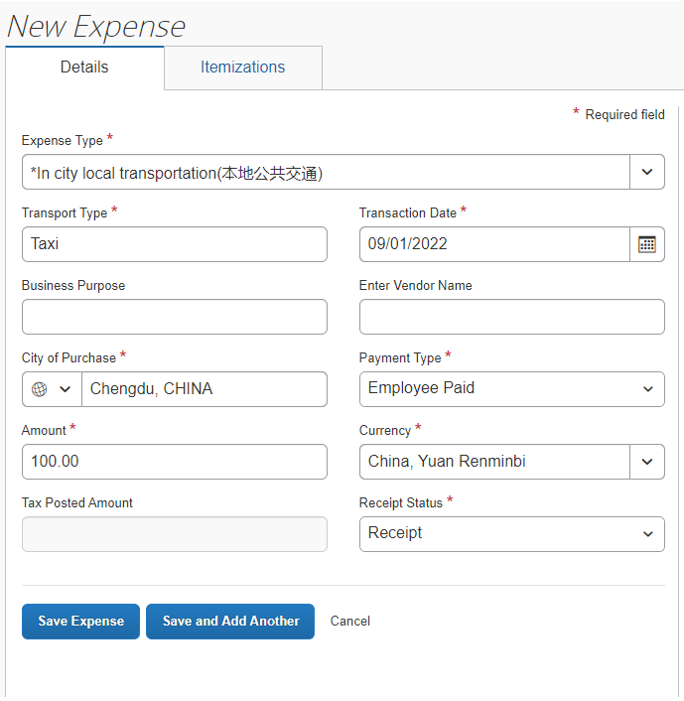
Local Transpor tation
Transport Type
“Taxi，Bus，Underground and Train... If train has been taken during the trip, please put select 'Travel Local Transportation’as the expense type”
Business Purpose"Travel deatils"
For International Travel, Amount currency can be changed accordingly. The exchanged rate can be manually update with support document attached.

Slide 19
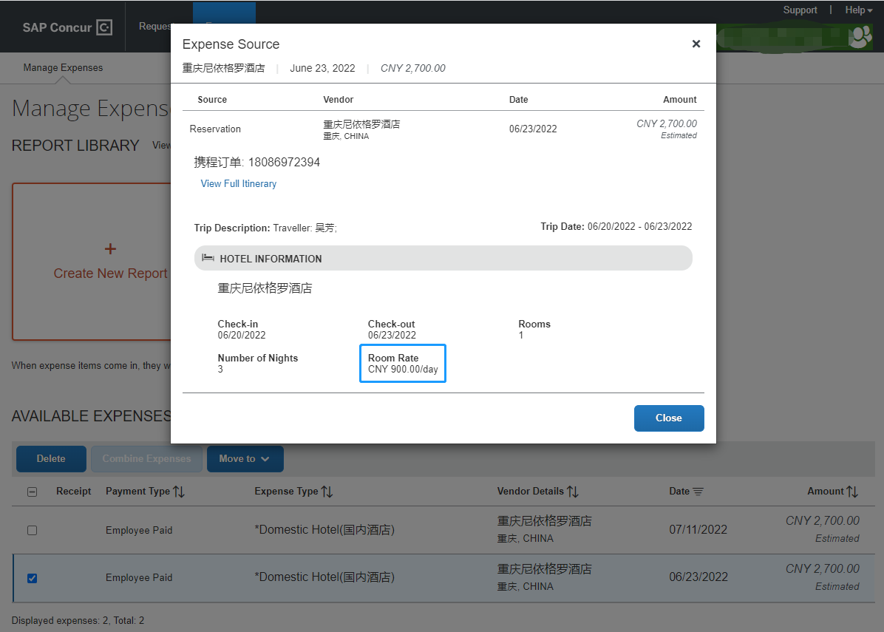
Domestic Hotel
When you create your expense report, you shall find your company paid domestic hotel expenses under
Available Expenses. Please select the hotel order and click “Move” to add it to your report.
You need to make a note of the room rate. When the hotel expense is imported to your report, the amount will require your manual input.
Select the expense and click Move, the following info will be added to your report: 1) Expense Type = Domestic Hotel, 2) Transaction Date, 3) Payment Type=Company Paid (Agency). However, amount will become zero.
Input the City of Purchase, actual hotel room rate (excluding other hotel services like laundry, etc.)
under Amount, and select applicable Request. Receipt Status should be Receipt.

Slide 20
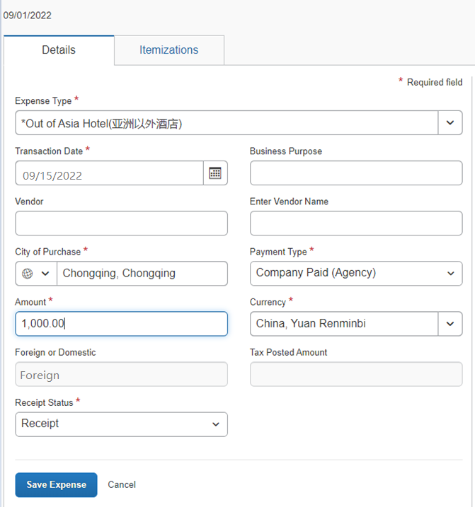
Asia & Out of Asia Hotel
Transaction Date "Check-OUT Date"
Business Purpose
"Travel Details"
Vendor "Hotel Name"
Amount "Total Amount for Whole Stay Including Tax, For international Travel. please select the currency accordingly, the exchange rate can be manually update with support document"
"
Receipt Status
"All Domestic Hotel Expense, please select Tax Receipt
FOR International Travel, please Company Paid(Agency)"
For domestic hotel, please refer to the separate manual broadcast.
If there is any further expenses (e.g. laundry, mini bar = travel meal) during the hotel stay, please create a
new expense under an appropriate expense type. Hotel is just for accommodation fee.

Slide 21
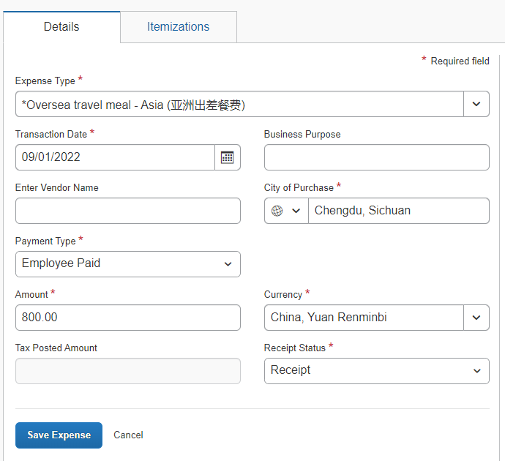
Meal
Transacte "Check-OUT Date"
If multiple meal allowance has been requested in Travel Request,(e.g. Beijing Trip Meal Allowance/ Shenzhen Trip Meal Allowance).Please select the correct matched Travel Request.

Slide 22
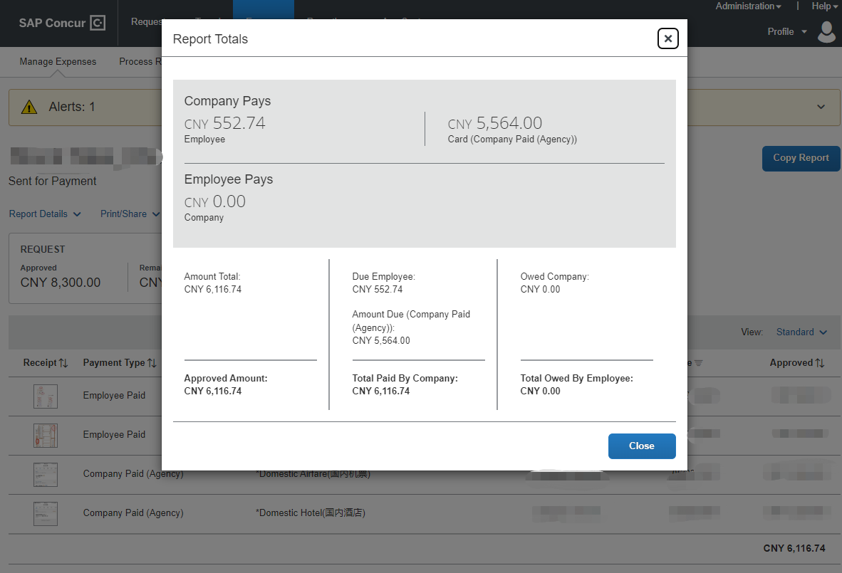
Summary
The expense report includes both company paid(flight ticket) and employee paid.
Click Report Details → Report Totals to check the details for both parts
Due Employee
The amount which employee will receive
Amount Due (Company paid Agency))
Company paid part
After adding all the expense, the Total Amount will be calculated.

Slide 23


Manage your expense reports
Before Approval
To call back the request, amend and submit again
After Approval

Slide 24
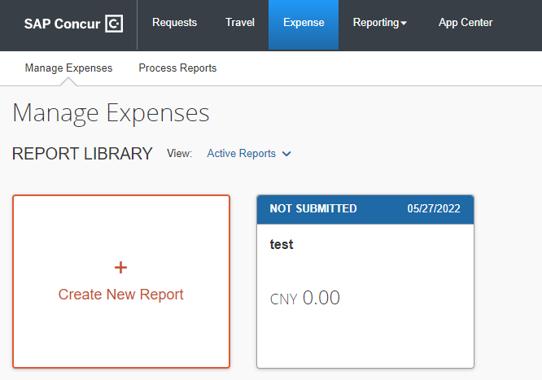
Non-Travel
Expense Claim
For non-travel expense claim, please go to Expense > Manage Expenses
> Create New Report
Draft reports are saved under Manage Expenses. You can edit before you submit the report.

